Slide 1
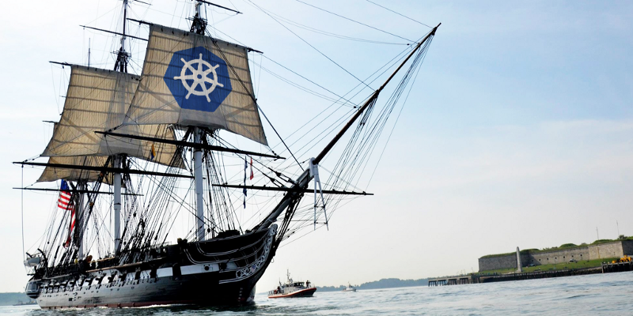
Using Kubernetes
Day 4
Nesia Amit & Eylon Malin

Slide 2
Agenda
Kubernetes Introduction
Liveness and Rediness Probes
ConfigMap and Secrets
Volumes
Volumes

Slide 3
Volumes
We Need Volumes for:
Persistent of Files
Need to share Files Between Containers

Slide 4

Container
File-System

Slide 5
Pod
File-System

Slide 6
Node
File-System
Node
kublet
Docker

Slide 7

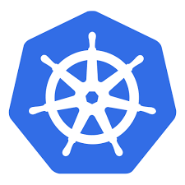
Kubernetes Cluster

Slide 8
Types of Volumes
configMap/Secret
projected
emptyDir
hostPath
NFS
CEPH
awsElasticBlockStore
azureDisk
azureFile
glusterFS
storageOS

Slide 9
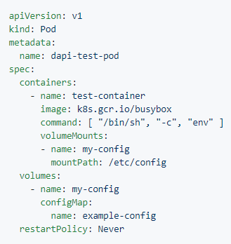
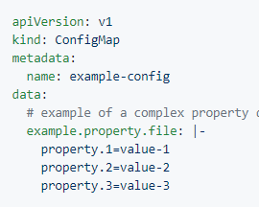
Volume - ConfigMap
my-config.yaml
$ kubectl apply –f my-config.yaml
$ kubectl create configmap --from-file=example.property.file

Slide 10
Volume - configMap
Master
eylonmalin/lets-chat-app:v1
configMap
/usr/src/app/config
Node
tmpfs
kublet
Docker

Slide 11
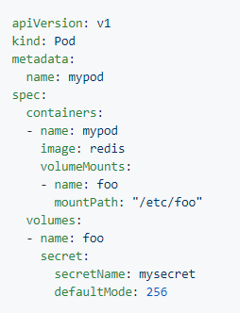
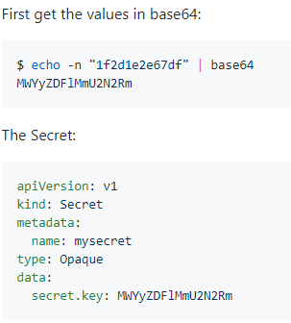
Volume - Secret
$ kubectl apply –f my-secret.yaml
$ kubectl create secret generic mysecret --from-file=secret.key

Slide 12
Volume – configMap
And Secret into
2 different Mount Paths
Master
eylonmalin/lets-chat-app:v1
configMap
/usr/src/app/config
Secret
/usr/src/app/docker
Node
tmpfs
kublet
Docker

Slide 13
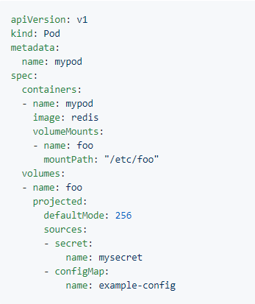
Volume -
Projected

Slide 14
Volume – configMap
And Secret into
The same Mount Path
Master
eylonmalin/lets-chat-app:v1
configMap
/usr/src/app/config
Secret
Node
tmpfs
kublet
Docker

Slide 15
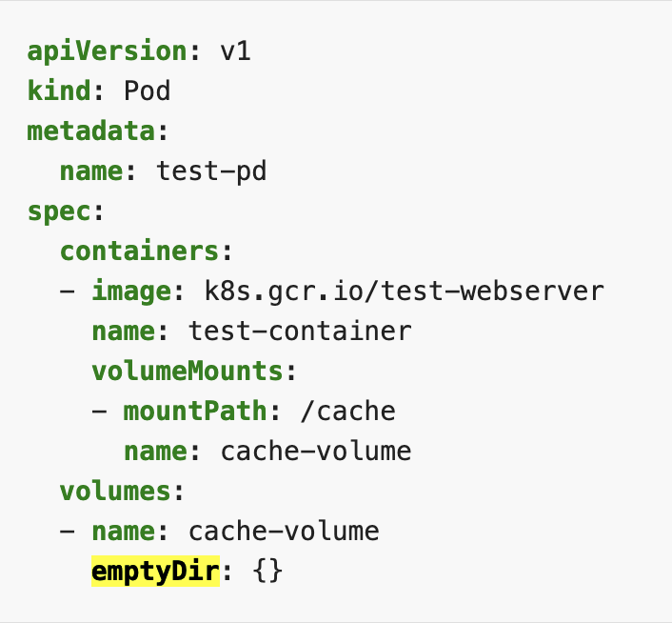
Volume -
emptyDir

Slide 16
Volume – emptyDir
Lets-chat-web Pod – with 2 Containers
eylonmalin/lets-chat-web:v1
blacklabelops/logrotate
/var/log/nginx/letschat
/var/logs/lets-chat
emptyDir

Slide 17
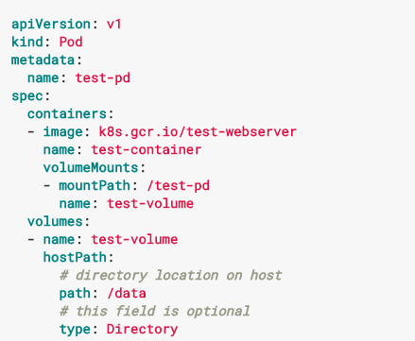
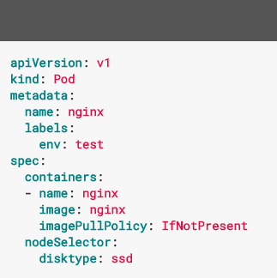
Volume - hostPath

Slide 18
Volume - hostPath
To Node
mongo
File-System
Node
kublet
Docker

Slide 19
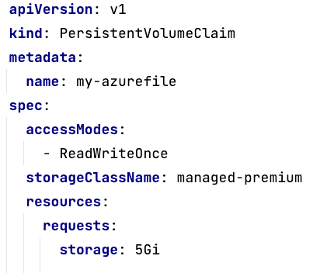
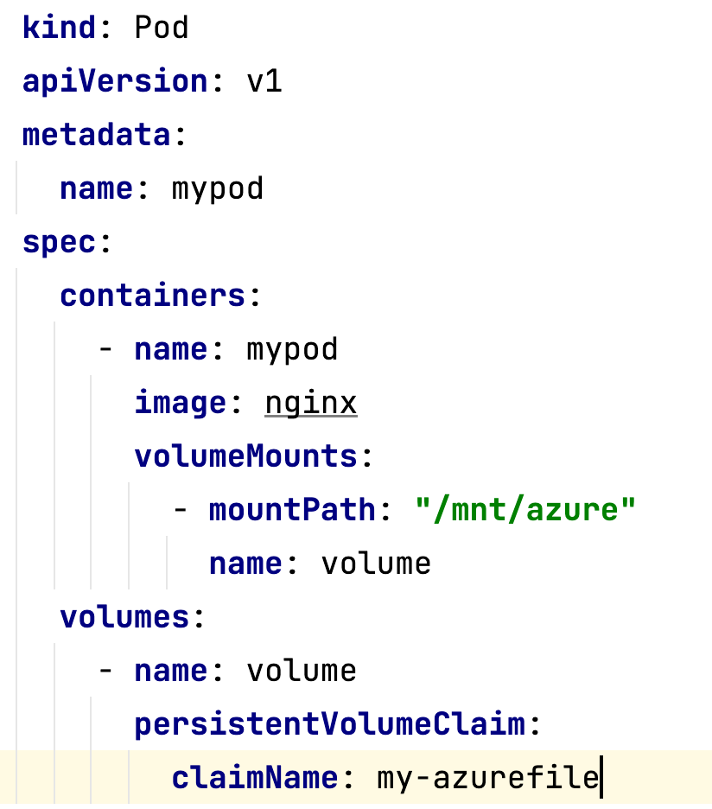
Volume – Persistent Volume Claim (PVC)

